Slide 1
BIG DATA PROJECT
Team 8:
Mohammed Elias khan – A0134607j
chonG YONGHUI BENJAMIN – A0134483E
Vadivel – a0134451n
KARUNA KEMMU – A0134559x
Yuchong – A0134514N

Slide 2
Business Objectives
Introduction
ECML/PKDD2005 Discovery Challenge shared open source data for Big Data analysis.
The data was obtained from a Czech electronics company running several internet shops.
Visualize the click streams to identify popular product categories and their listings
Discover peak traffic patterns to plan marketing campaigns
Analyze which countries the customers are from, as part of demographic segmentation

Slide 3
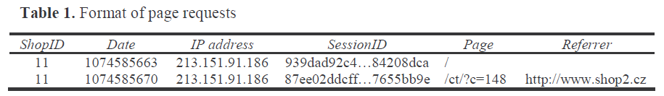
Data Description
File format considered: Semi-colon separated Log Files
No. of Page Views = 3,617,171
Timeline = 3 weeks
No of internet shops (websites) = 7
Data size = 442 MB

Slide 4
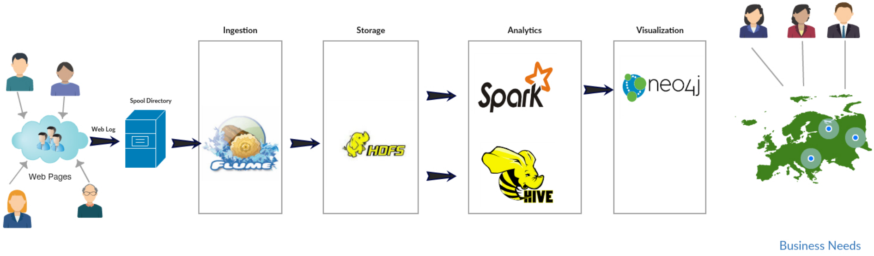
Architecture

Slide 5
Challenges
Access Issues:
Reading data from Hive to Spark
Download Docker container for allowing Maze runner to interact between Neo4j and Spark
Knowledge Issues:
Connect Zeppelin – Hive interpreter not found

